Slide 1
WIRELESS MOBILE CHARGING SYSYTEM

Slide 2
ABSTRACT:
The main objective of Wireless Charger System is to charge the mobile battery by using wireless charger.
The dream of wireless charging is just to be able to plop your phone on a shelf after work and have it fully charged when you pick it up again on your way out.
This technology will replace cables and standardize on one interface, potentially being able to adjust power settings to charge different types of batteries.
In our Wireless charging system there are two circuits, a transmitter circuit and a receiver circuit.

Slide 3
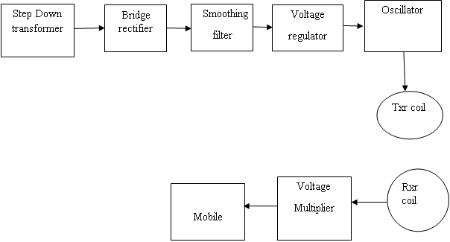
Block Diagram:

Slide 4
Block Diagram Explanation:
The block diagram of wireless charger consists of Ac power supplier, rectifier, LC oscillator circuit, transmitter, receiver and current amplifier, which is shown in fig. 2. In the first step AC supply of 220V is given to the circuit, then transformer is connected which convert this 220V to 18V supply. This converted 18V is of AC nature and for further process this supply needs to convert into DC supply. For conversion, bridge rectifier is used. The conversion process of AC to DC gives ripples in output. For removing ripples a filter circuit is needed which consist of capacitor and resistor. After this smooth DC is obtained which is supplied to oscillator circuit consist of inductor and capacitor. Oscillators convert a DC input (the supply voltage) into an AC output (the waveform), which can have a wide range of different wave shapes and frequencies that can be either complicated in nature or simple sine waves depending upon the application. Then this signal is given to transmitter which transmits the signal. Then it is receive by receiver. The mobile phones are not charged at AC so we need to convert it again in DC output.

Slide 5
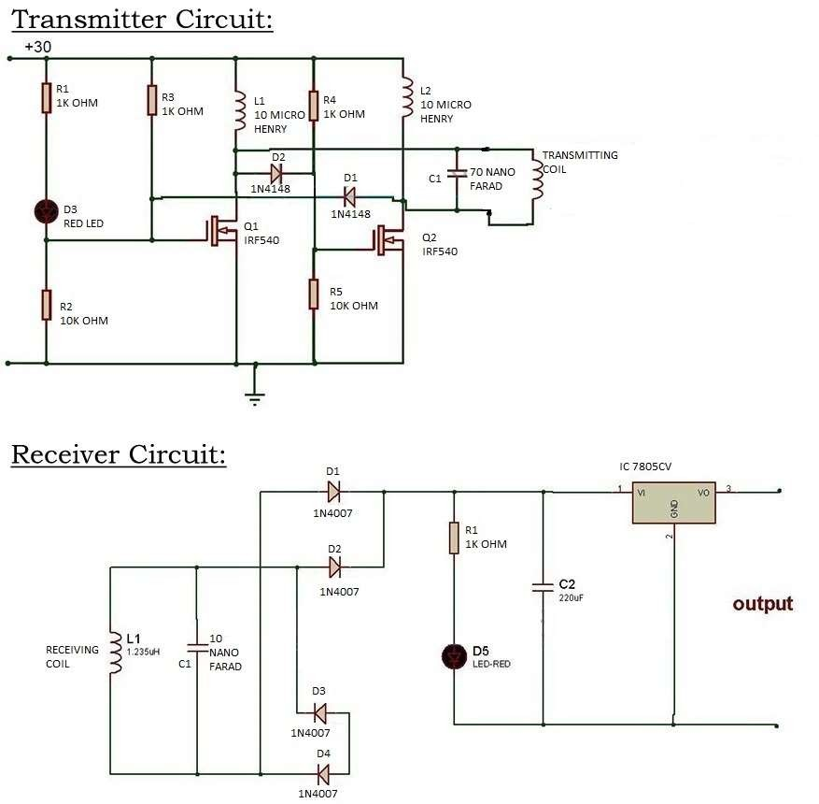

Slide 6
Circuit Diagram Explanation
The transmitter circuit consists of step down transformer of 230/12V. This transformer steps down 230V AC from main supply to 12V AC. Then that 12V AC is converted into 12V DC with the help of bridge rectifier. After that a 2200/25V capacitor is used to filter the ripples and pure DC is supplied. Then the oscillator circuit oscillates at 10MHz and with the help of transmitting coil it transmits the wireless power.
The receiver circuit receives the power through receiving coil and passes through voltage multiplier circuit (consisting of diode and capacitor voltage multiplier) and through that voltage the mobile charging is achieved

Slide 7
HARDWARE'S
Stepdown Transformers
Inductive Coils
Regulator

Slide 8
Advantages:
Cost efficient

Slide 9
Applications:
Mobile power supply applications
camera batteries
Bluetooth headsets
Medical devices

